Slide 1
IEEE SOLDERING WORKSHOP FALL 2017
SAHIL GANDHI & LIZ XUE

Slide 2
UNDERSTANDING SOLDERING
- Formation of a “metal to metal” joint using solder
During this workshop, we will:
Go over some soldering tools
Illustrate important soldering techniques
Introduce the project
Get to work!
Notes:
In other words, you use a metal that has a low melting point to adhere surfaces to be soldered together.
Soldering is also a must-have skill for all sorts of electrical and electronics work.

Slide 3
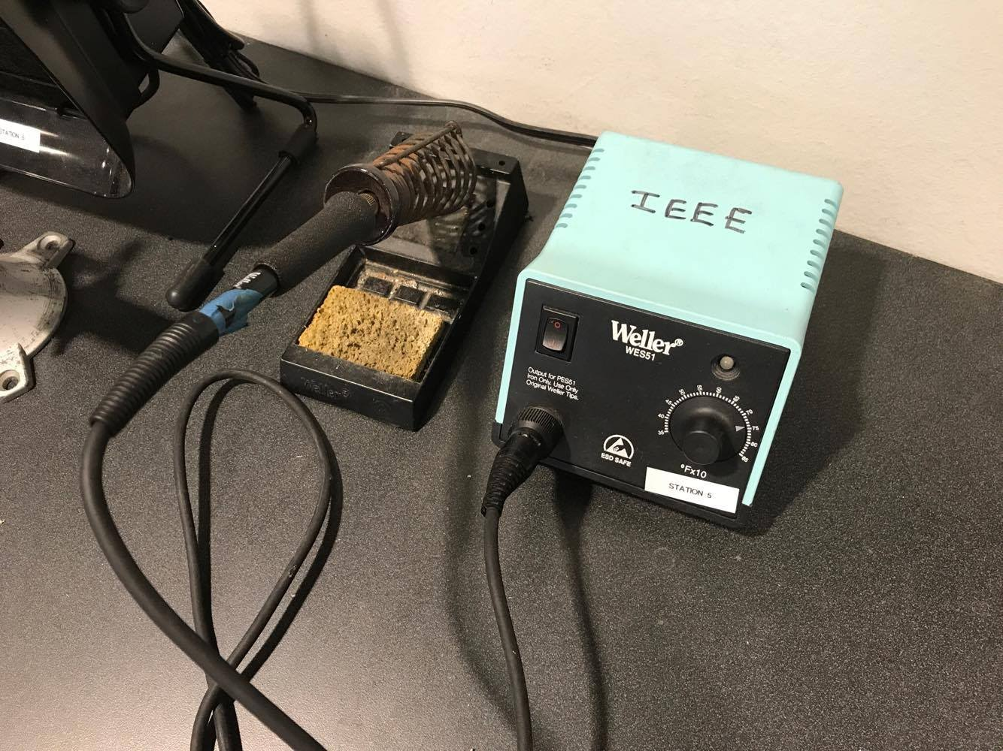
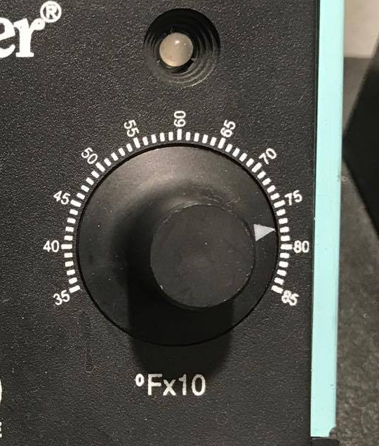
TOOLS
We usually set temperature to 650-750 ˚F to melt solder and heat pins without fumes or burning.
Soldering iron
Soldering Station
Notes:
Units is in 10 Fahrenheit degrees!

Slide 4
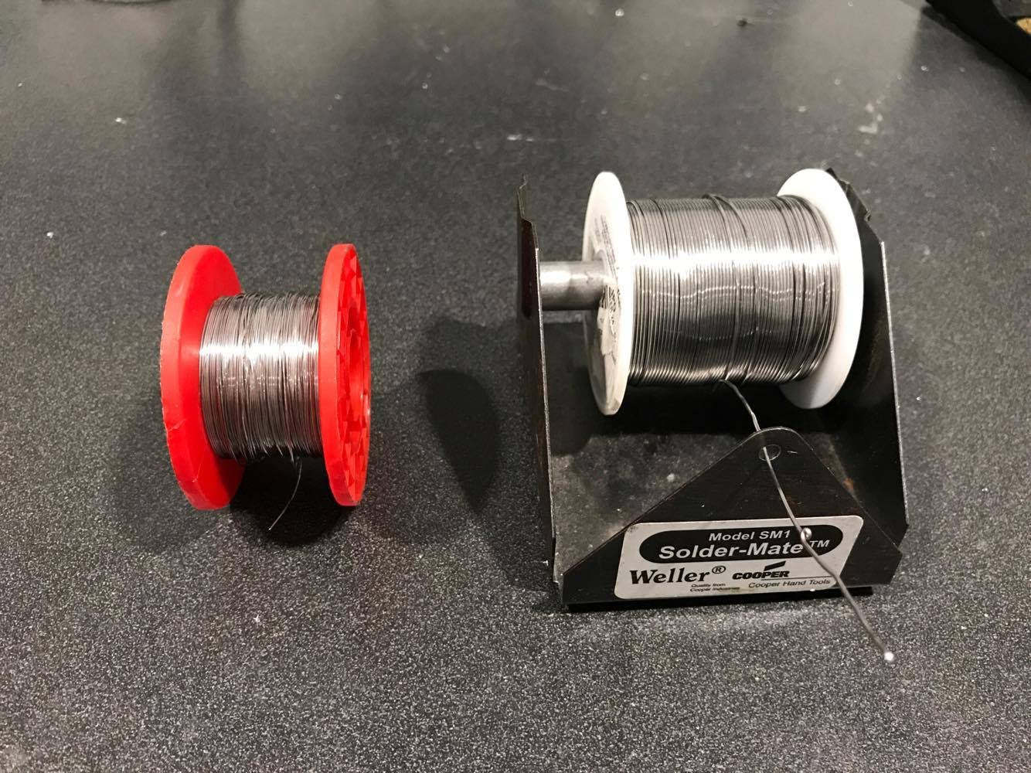
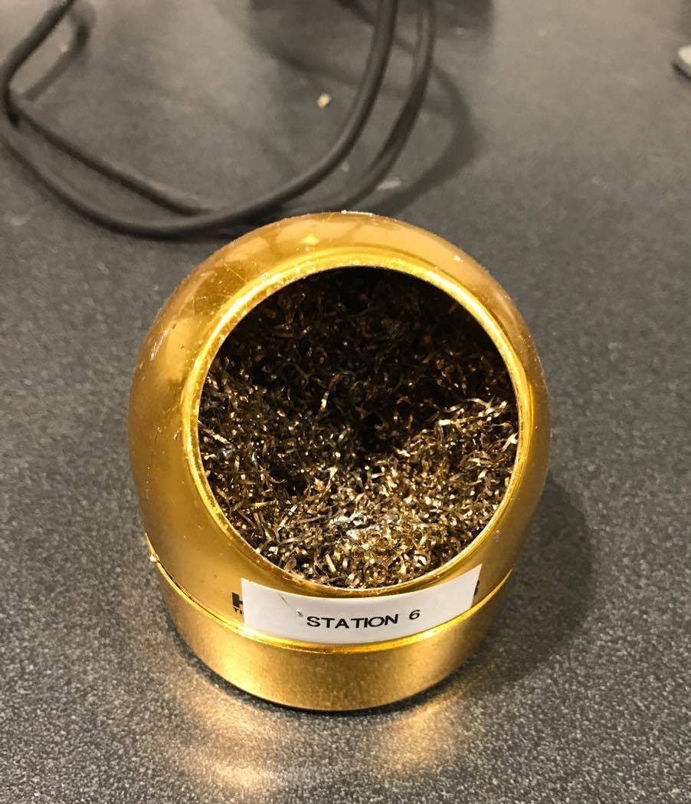
-Different sizes of solder
-Depends on the size of the metal pads on your circuit board
Tip Cleaner(brass wool)
Notes:
Keep your iron tip clean at all times.

Slide 5
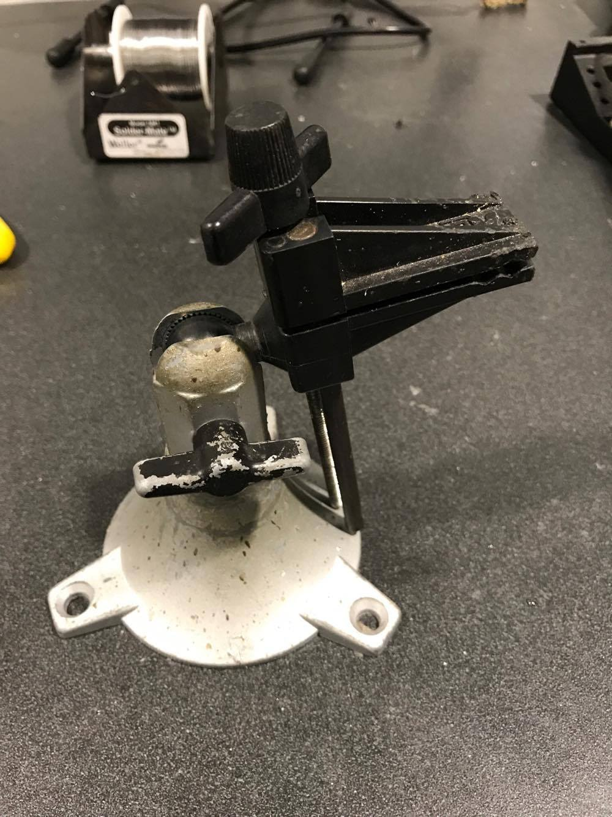
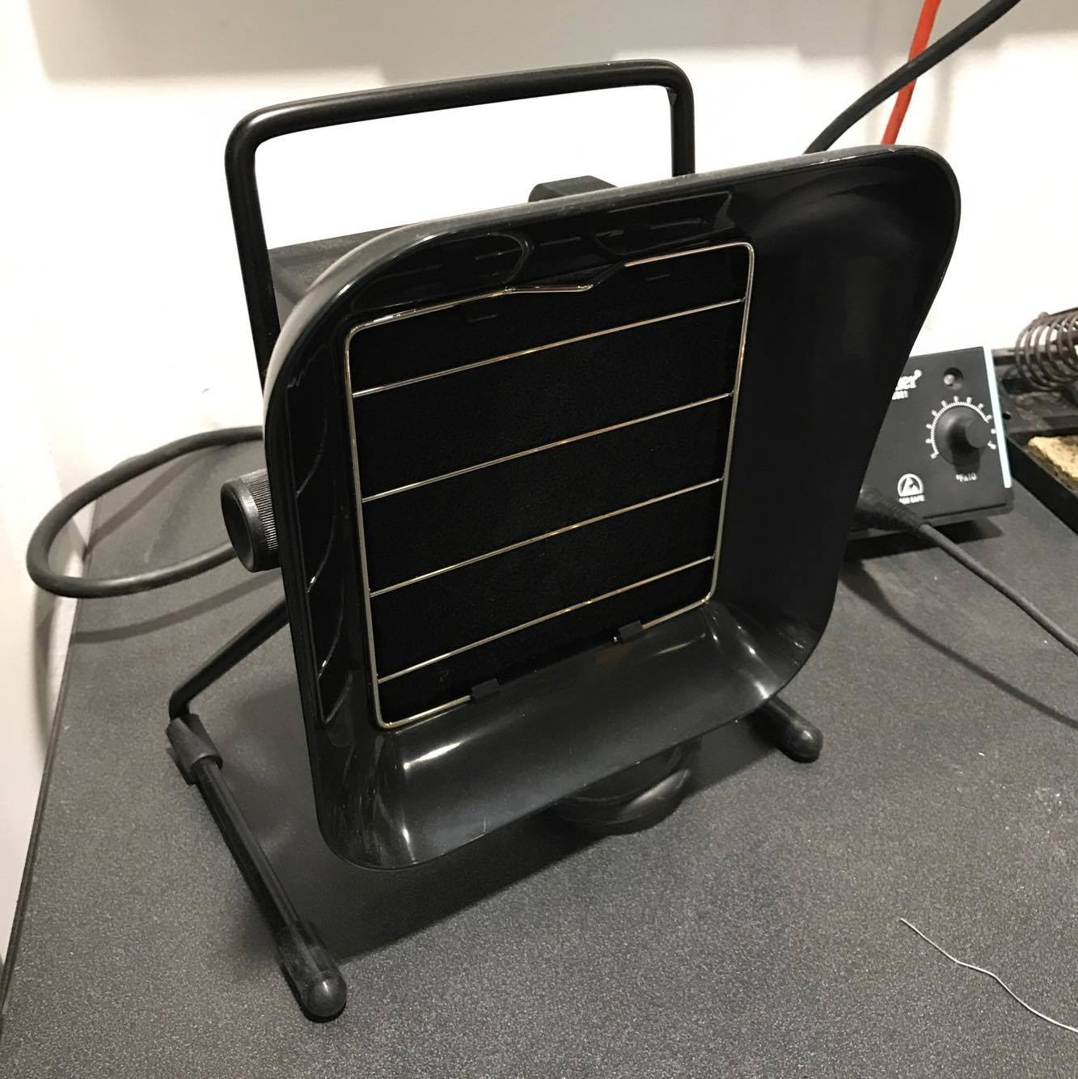
Clamps (to hold your board)
Fan
Notes:
Use two hands to solder, so need the clamps to keep the board stable
Harmful fumes

Slide 6
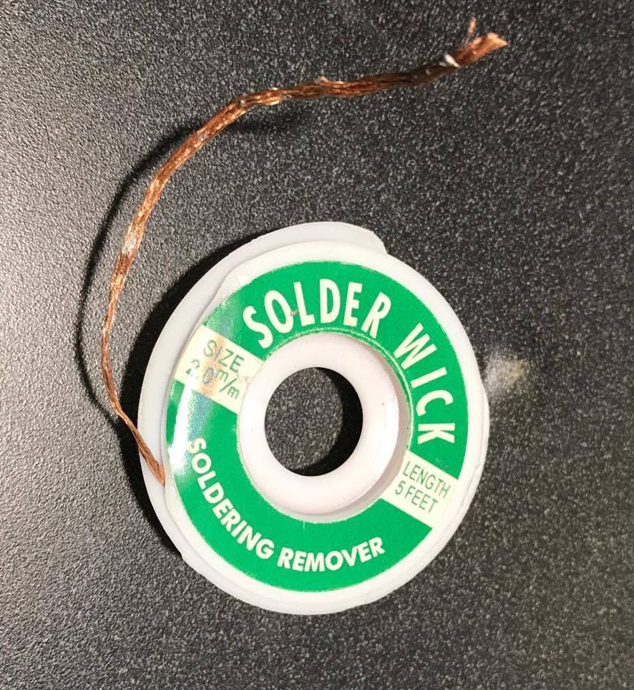
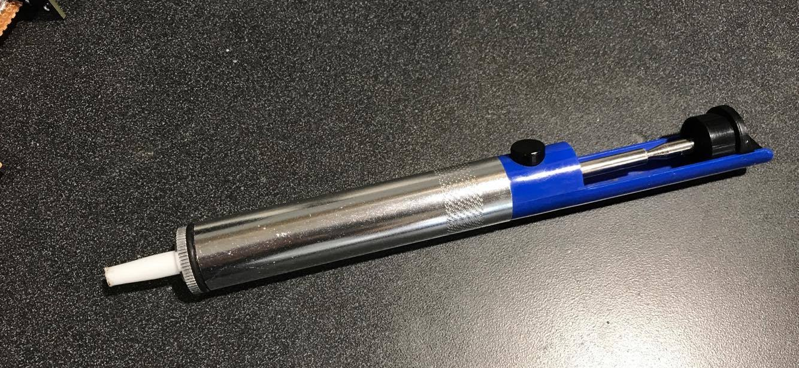
What if I messed it up?
Solder Sucker
Solder Wick

Slide 7
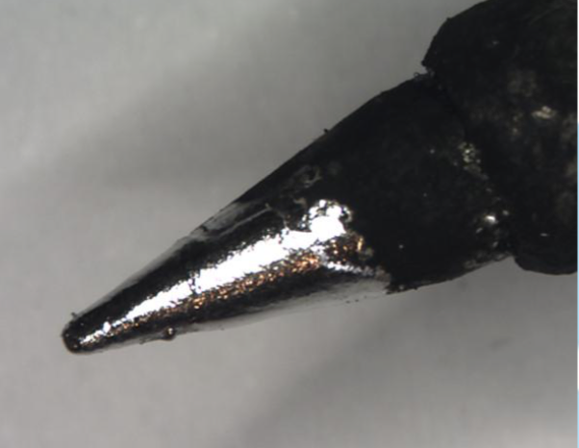
TINNING
Clean the tip with brass wool and then apply a thin layer of solder
Prevents oxidization
Better heat transfer

Slide 8
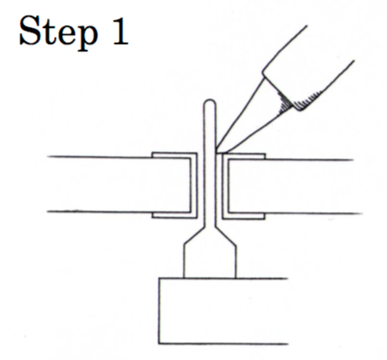
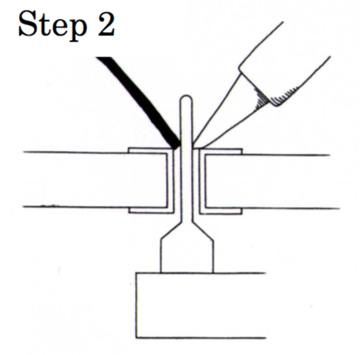
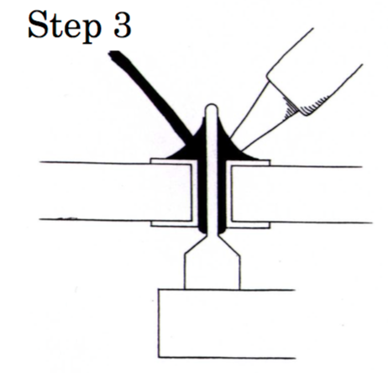
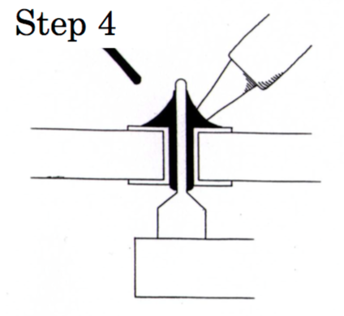
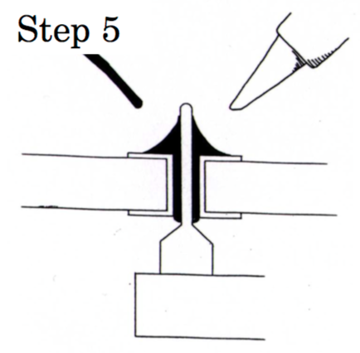
TECHNIQUES
Notes:
- Do not let the soldering iron stay on the parts to be soldered too long. What this does is oxidize the metal, making it too dirty to attract solder. If you are working with a circuit board, too much heat can damage the board.
Make sure solder melts from heat of the pad, NOT from touching the iron

Slide 9
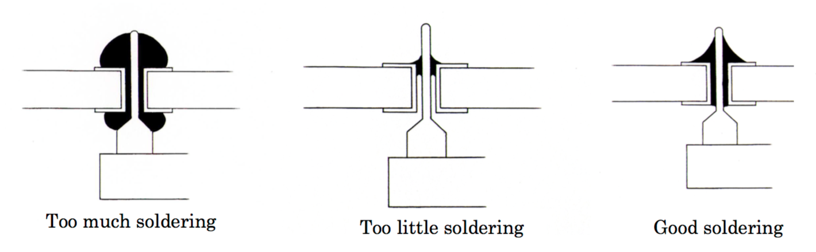
“Volcano” Shape Joint
Notes:
A cold joint is a joint in which the solder does not make good contact with the component lead or printed circuit board pad. It is often characterized by a rough or lumpy surface. Cold joints are unreliable. This can be fixed by first removing the old solder with a desoldering tool or simply re-heating the joint with a hot iron until the solder flows.

Slide 10
SAFETY
Harmful fumes will be released. Therefore always work in a well-ventilated area.
Iron is VERY HOT!
Hot melted solder is dangerous too! Do not let it splash.
Always wash your hands after soldering!
Turn off the soldering station when you are done!

Slide 11
SOLDERING KIT
Here are the components in your kit:

Slide 12
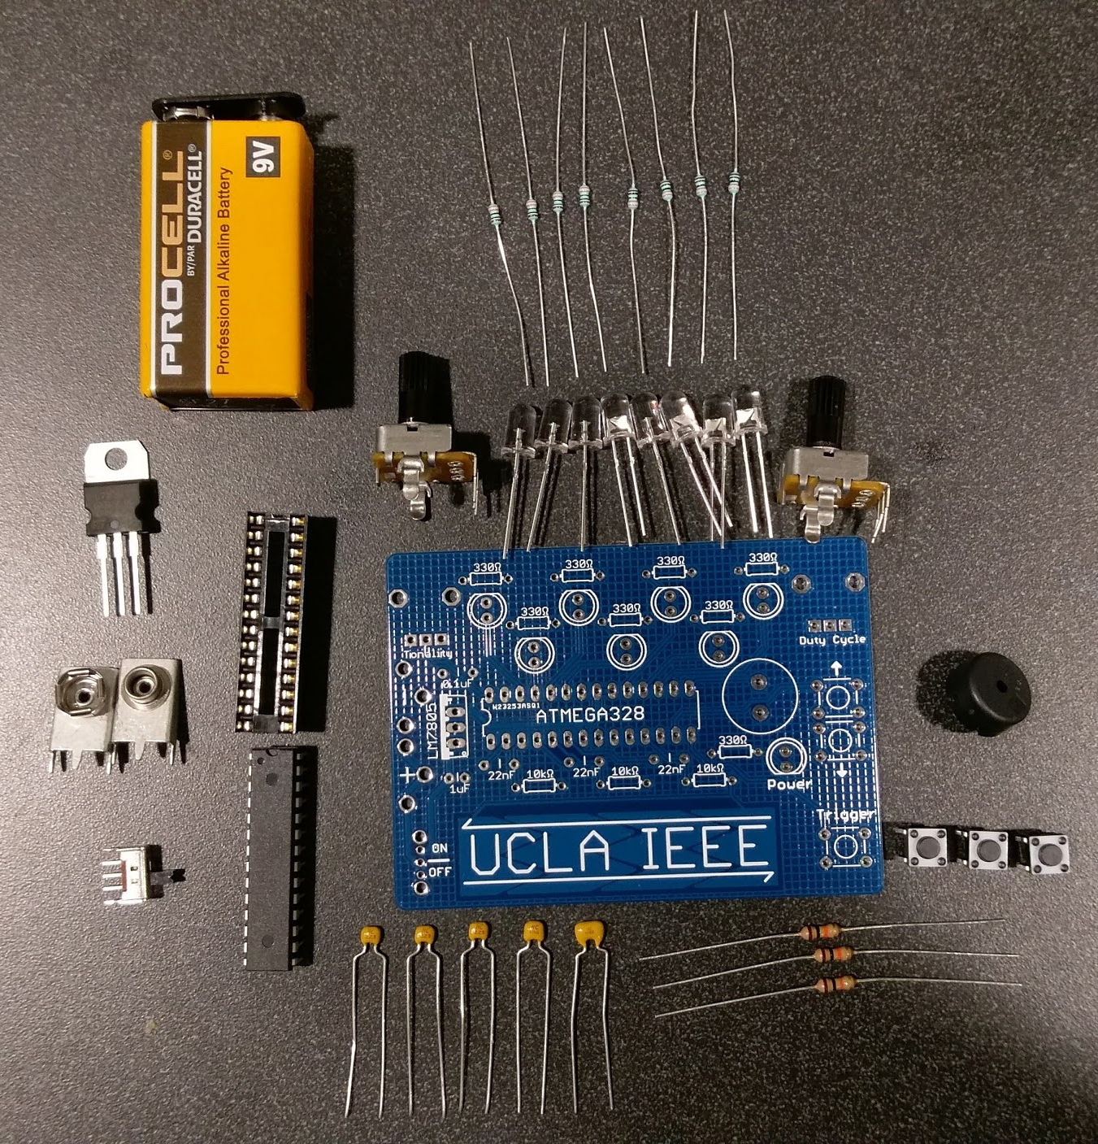
PARTS
8x 330Ω Resistors
LEDs (8)
9V Battery
Potentiometer
5V Regulator
DIP Socket
Buzzer
9V Battery Holders
SPDT Switch
PCB
MCU
3x Buttons
Capacitors
3x 10kΩ Resistors

Slide 13
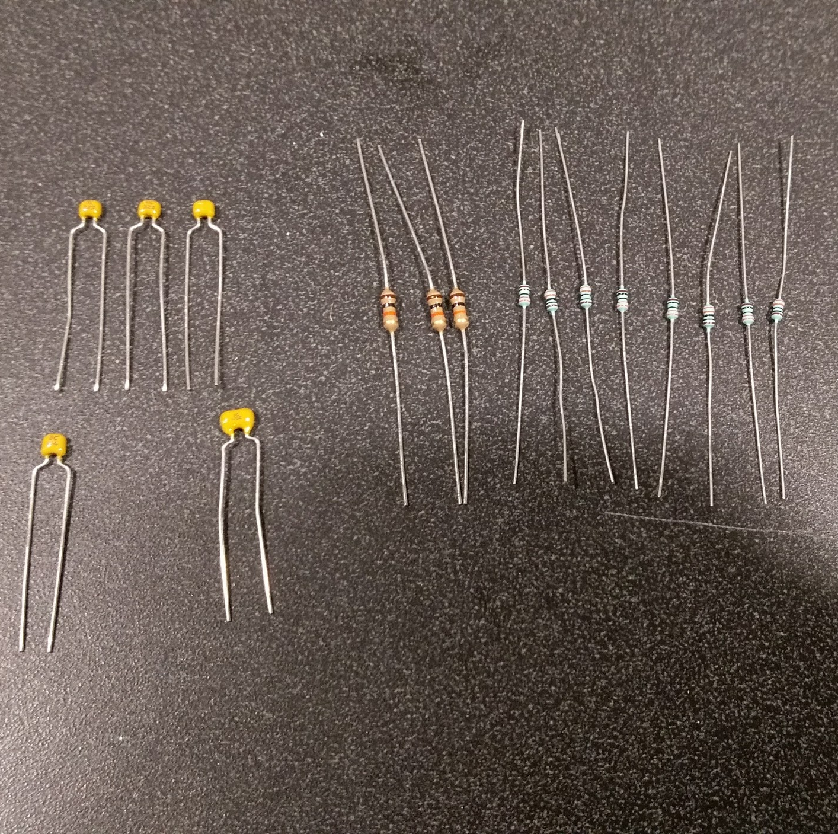
PASSIVES
22nF Capacitors
(223)
330Ω Resistor
(Orange, Orange, Black, Black, Brown)
0.1µF Capacitor
(104)
10KΩ Resistor
(Brown, Black, Orange, Gold)
1µF Capacitor
(1052)

Slide 14
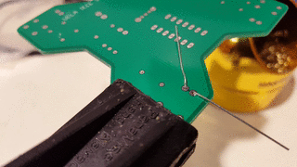
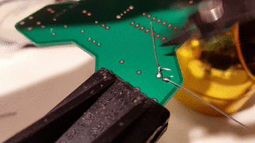
SOLDERING A JOINT
Apply heat with iron
Push solder into joint from opposite side
Ensure that solder covers pad completely
“volcano” shape
Remove excess wire

Slide 15
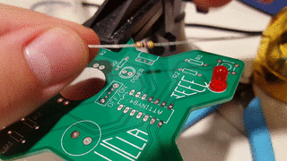
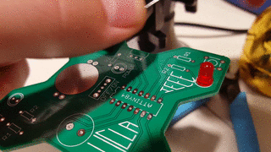
INSTALLING RESISTORS
1
2
Bend leads
Press firmly into holes until resistor lays flat

Slide 16
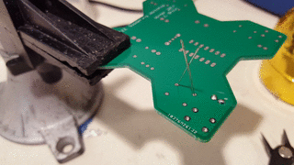
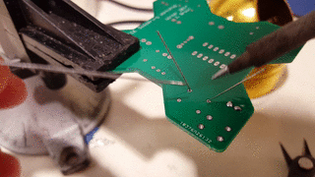
INSTALLING RESISTORS (CONTINUED)
3
4
Bend leads for soldering
Solder

Slide 17
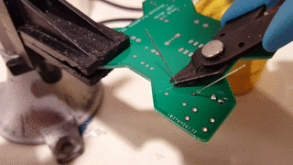
INSTALLING RESISTORS (CONTINUED)
5
Clip excess wire

Slide 18
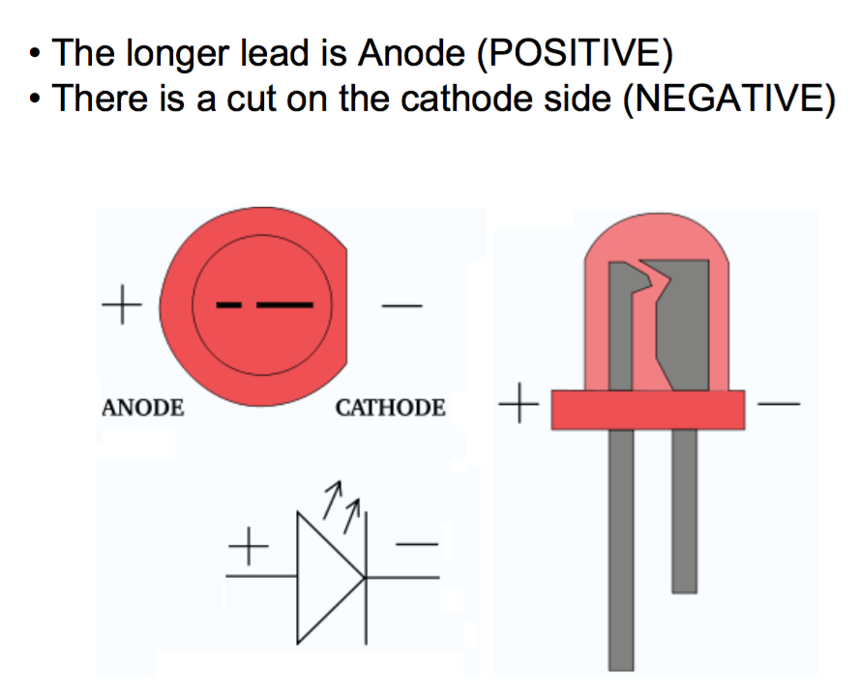
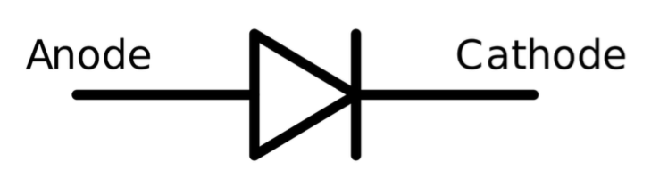
POLARITY
Some electrical components need to be placed in the correct orientation
Diodes:
LEDs:

Slide 19
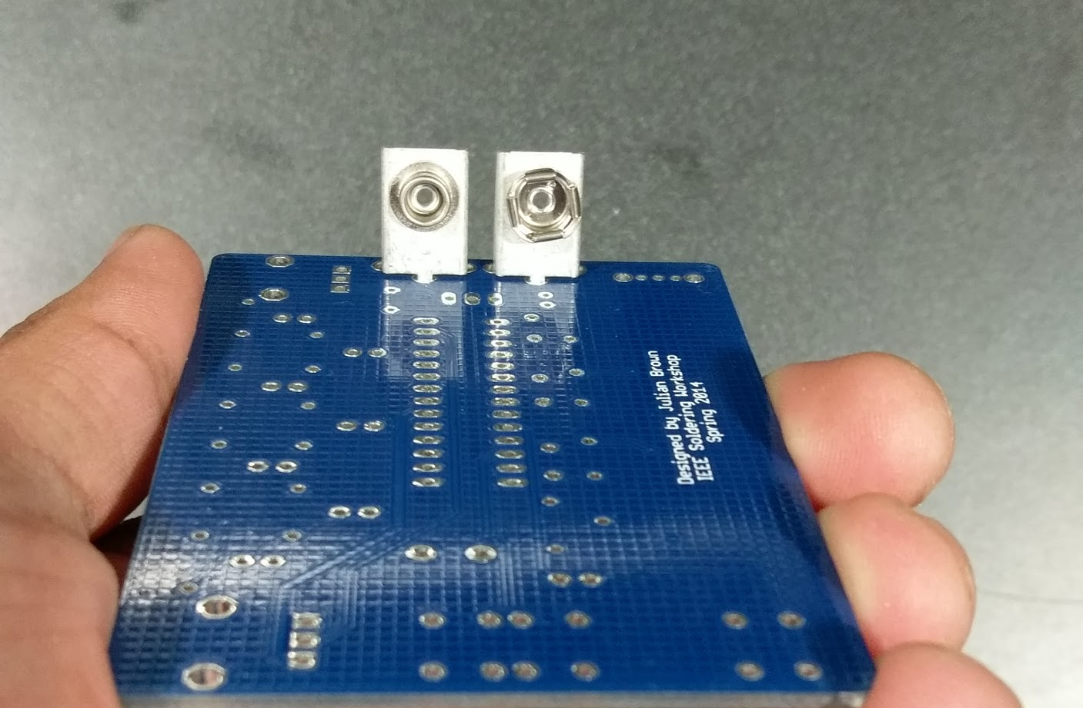
INSTALLING 9V BATTERY CLIPS
-
+

Slide 20
Order that we will solder:
Resistors -> 10k Resistor (brown black orange code), 330 Ohm resistor (orange orange black black code)
Capacitors -> 223 (22nF), 104 (0.1 uF), and then 1052 (1uF)
Dip socket -> Look for the ‘u’ notch to place the socket
LEDs -> Longer lead is positive, as is the rounded part (non-flat part)
5 V regulator -> Flat metal part is where the bold white rectangle is on the PCB
Potentiometer / Buzzer / Dip switch / Pushbuttons

Slide 21
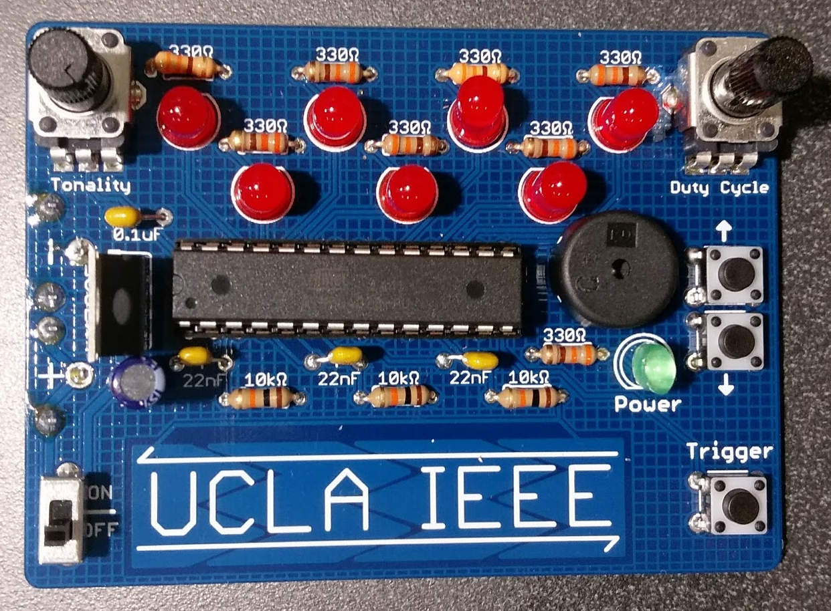
INSTALLING EVERYTHING ELSE
Capacitors
Potentiometers
Voltage Regulator
Power Switch

Slide 22
Have fun soldering!

Slide 23
Flashing the MCU:
Code can be found on our Github: https://github.com/sahilmgandhi/IEEE_Workshops_2017_2018
The chip that we used is an ATMEGA-328
Have fun with your project!

